Slide 1

1

Slide 2


Outlook Macros Attack (Melissa Virus)

Slide 3
Contents
2
▶ 1. Melissa and its outbreak…....……………………………………………..Slide 3.
▶ 2. Examine the body of Melissa……………………………………………..Slide 6.
▶ 3. How Melissa hides its activities……………………………………………Slide 13.
▶ 4. Dealing with Melissa……………………………………………………......Slide 14.
▶ 5. Appendix……………………………………………………………………..Slide 16.
▶ 6. References……………………………………………………………………Slide 17.

Slide 4

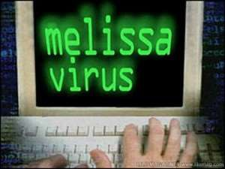



1. Melissa virus and its outbreak
3
▶ A perfect example of the combination of booty and brain.
▶ Imagine that you mix a stripper with a hacker, then you will have the first successful email-aware macro virus that is considered as one of the most destructive of all time.^{[1]}

Slide 5
4
▶ The Melissa virus or W97M.Melissa.A, also known as W97M.Mailissa, Kwyjibo, or Simpsons, is a macro virus. It was written in Visual Basic by David L. Smith
a.k.a. Kwyjibo from New Jersey.
▶ It infects a Microsoft Word 97 or Word 2000 document by adding a new macro module named Melissa and spreads among Microsoft Outlook users.^{[4]} The virus only works with Outlook, not Outlook Express.

Slide 6

4
▶ It has an “additional feature of being able to get around quickly”. The virus was announced to have infected up to 20% of computers worldwide, and the estimated damage was reported $1.1 billion.
▶ Smith wrote this just to impress the stripper he had met in Florida, her name is Melissa. However, he never thought it would cause such that havoc.

Slide 7
Outbreak
5
▶ Melissa was put in the wild in around March 26, 1999. It started as an infected file “list.doc” that was posted up on “alt.sex” newsgroup, claiming to be a list of usernames and passwords for 80 pornographic sites that require memberships.
▶ Once executed (when macros were enabled), the original version of Melissa opens Outlook and sends itself to the first 50 addresses in the address book. If Internet access or Outlook were not available, it would still infect other word documents.

Slide 8
Outbreak
5
▶ Actually, Melissa did not do too much damage to infected user’s PC. However, its mechanisms caused Denial of Service (DOS) attacks to organizations’ network system that relied on MS Outlook as their email client such as Microsoft, Intel, and many Several major more corporations had to shutdown their mail servers as they became overloaded with messages created by the virus

Slide 9
2. Examine the body of Melissa
6
▶ The subject of the email is "Important Message From <Username>“, where “Username” is taken from MS Word setting. The body of the message is "Here is that document you asked for ... don't show anyone else ;-)". The attachment is usually “list.doc”.

Slide 10
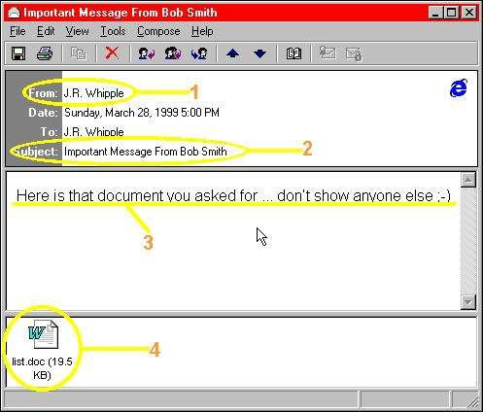
7

Slide 11
Behaviors
8
▶ When an infected document is opened, Melissa checks if the Microsoft Office registry entry "HKEY_CURRENT_USER\Software\Microsoft\Office" has a subdirectory named "Melissa?" exists with "... by Kwyjibo" set as its value.
▶ If the value was set, meaning this computer had been infected before, the virus would not do anything. If the value was not set, its primary payload would start the infection and then set the value.^{[4]}

Slide 12
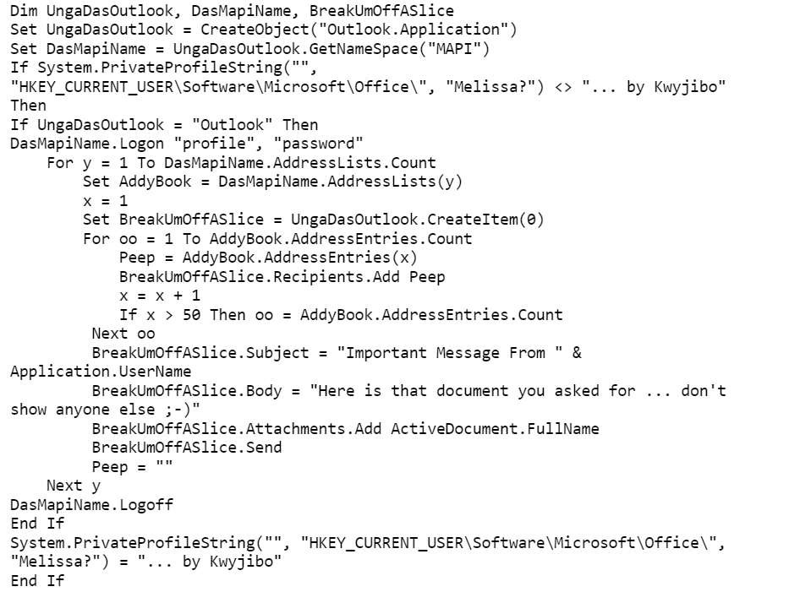
9

Slide 13
▶ In a small percentage of cases (when the day of the month equals the minute value), the second payload of Melissa will insert the following sentence at the current cursor position:
10
▶ The quote is from Bart of “The Simpsons” cartoon show, who invents the word Kwyjibo to describe a North American ape or his father Homer in a Scrabble-playing episode.

Slide 14
11
▶ The macro then infects the NORMAL.DOT template file. By default, all Word documents utilize this template; thus, any other opened Word document could be infected.
▶ If users send these infected documents to other people, they indirectly lend Melissa a hand in propagating it.

Slide 15
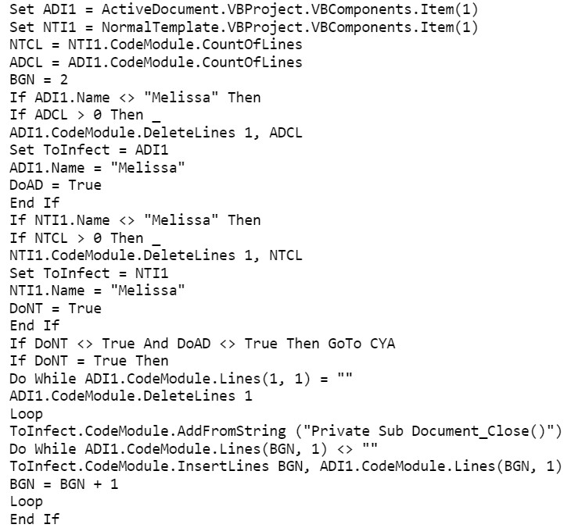
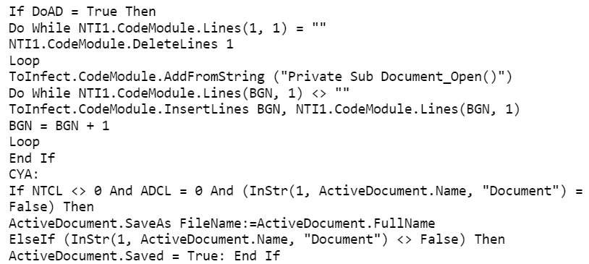
12

Slide 16
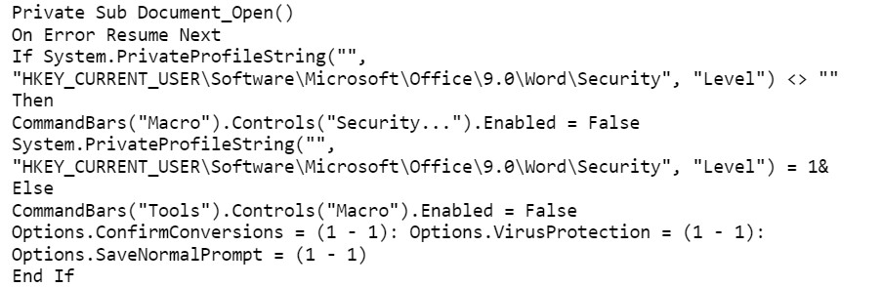
3. How Melissa hides its activities
13
▶ Similar to most macro viruses, this virus tries to hide its activities by disabling the following menu items:
+ Tools-Macro in MS Word 97: By disabling this menu command, the virus prevents any user from listing the macro / VBA module in MS Word 97 to manually check for infection.
+ Macro-Security in MS Word 2000: By disabling this menu command, it prevents the user from changing the security level in MS Word 2000.^{[4]}

Slide 17
14
▶ To hide its infection activities, it also disables the following options in MS Word 97:
Prompt to save Normal template
Confirm conversion at Open
Macro virus protection
▶ With these options disabled, MS Word 97 does not warn or prompt while saving the NORMAL.DOT or while opening a document with macros in it.^{[4]}

Slide 18
4. Dealing with Melissa
15
▶ Melissa is not too hard to detect for Anti-Virus (AV) corporations. However, its propagation speed was extremely quick, can be counted by hour. It had caused a huge havoc before AV corporations jumped in. In some cases, the infected files could not be restored to their original
▶ Melissa causes changes in template file; therefore, AV software could use checksum method to detect it. Microsoft also came up with a free tool to clean up an infected mail database.
▶ Melissa depends on user’s action to activate; thus, it could be avoided. There are
several ways to deal with this bad girl such as:
+ Learn its signatures to avoid mis-opening the infected file.
+ Configuring mail system to filter out messages that may contain Melissa.
+ Disable macros.
+ Scan the whole system with up-to-date AV.

Slide 19
6. Appendix
17
▶ The full source code of Melissa virus can be found at: http://www.cs.miami.edu/~burt/learning/Csc521.061/notes/melissa.txt University of Miami.^{[14]}
Note: You need to turn off your Anti-Virus in order to view this file. Don’t worry about the virus because it cannot infect the latest MS Word and Outlook.
▶ A short video of how Melissa works can be found on YouTube at:
https://www.youtube.com/watch?v=iBGIUd9niXc Uploaded by danooct1.^{[13]}
Subscribe his channel for more videos about viruses.

Slide 20


Thank you!
Any Questions ?

